Slide 1
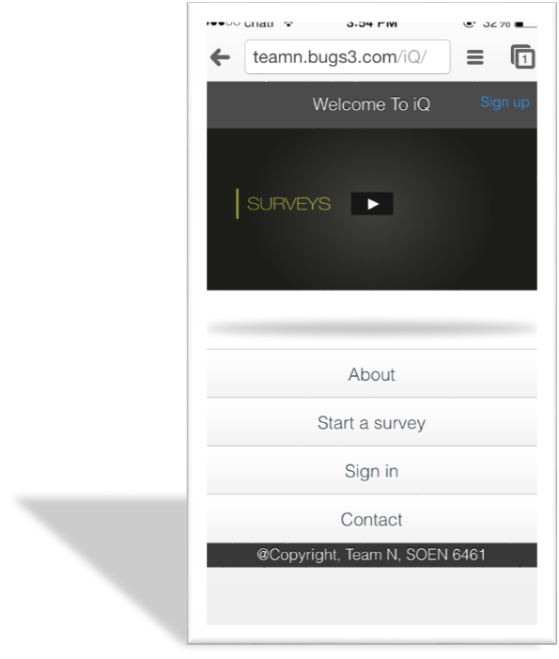
IQ Survey System For
UX Designer
SOEN 6461
Presented by Heng Wang (Team N)

Slide 2
Table of content
Domain Model
Use Case Model
User Roles
Implemented user stories
Macro Level Architecture
High-Fidelity Prototype
Demonstration
SOEN 6461

Slide 3
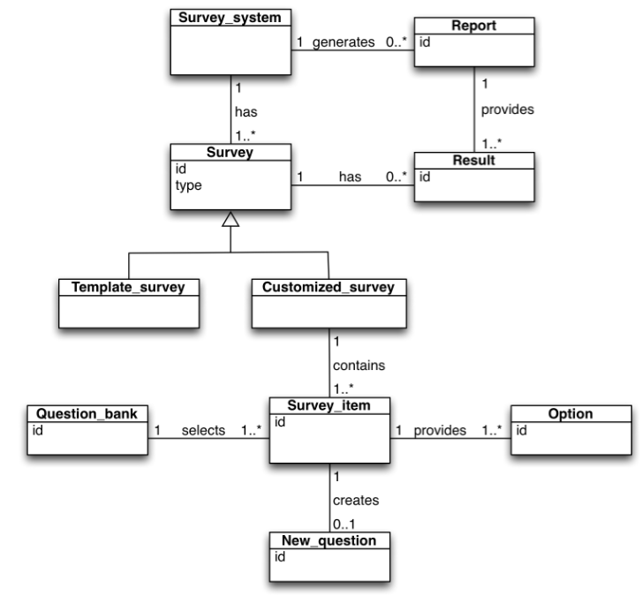
DOMAIN MODEL
SOEN 6461

Slide 4
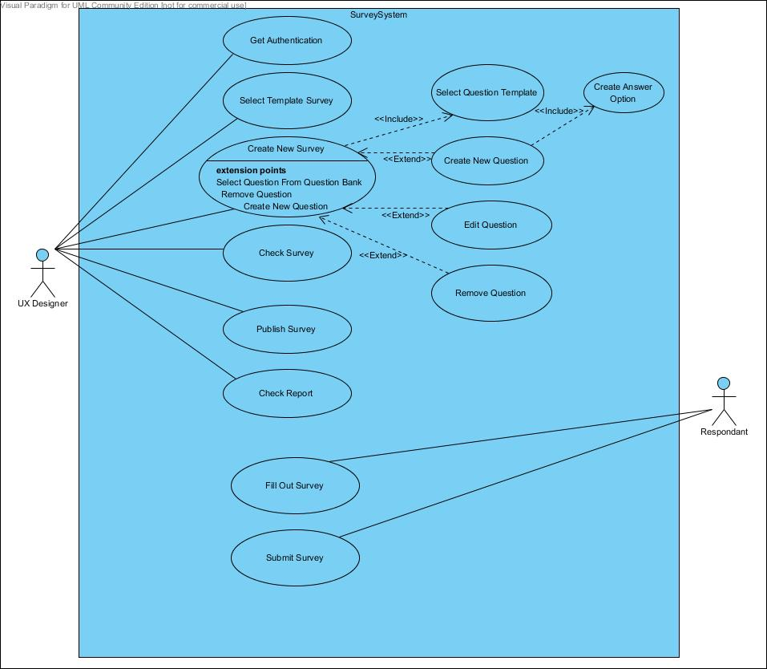
USE CASE MODEL
SOEN 6461

Slide 5
User Roles
UX_Designer
Respondant
SOEN 6461

Slide 6
Implemented User Stories
Registration
Get Authentication
Deauthentication
Create New Survey
Select Template Survey
Create New Question
Create Answer Option For New Created Question
Select Question Template
Check Survey
Publish Survey
Fill Out Survey
Check Report
SOEN 6461

Slide 7
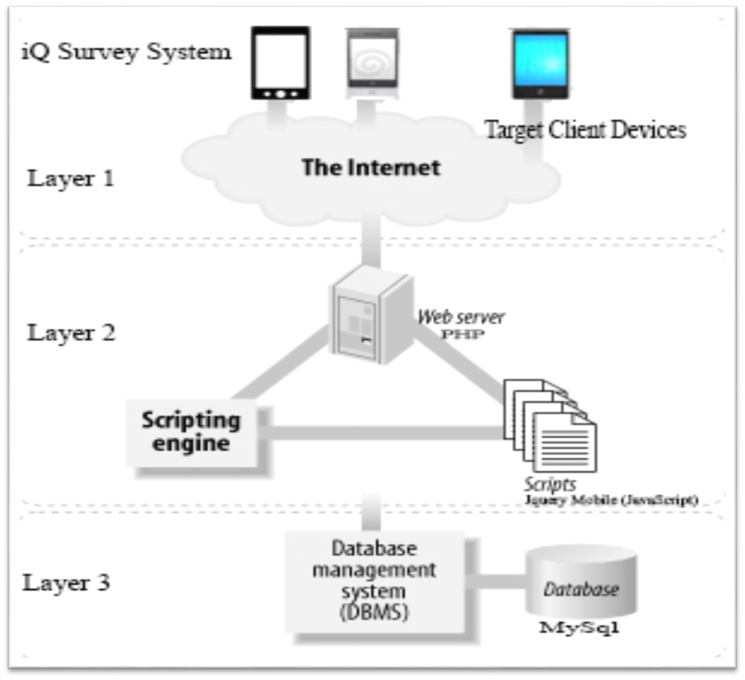
Macro Level Architecture
SOEN 6461

Slide 8
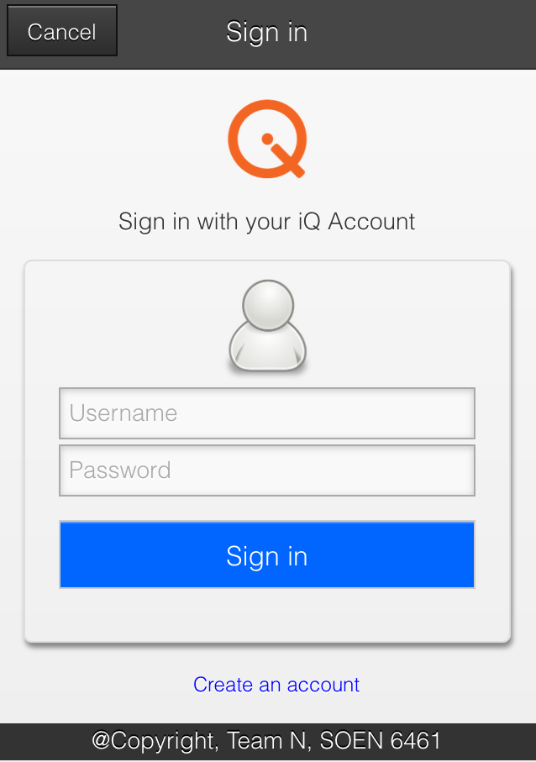
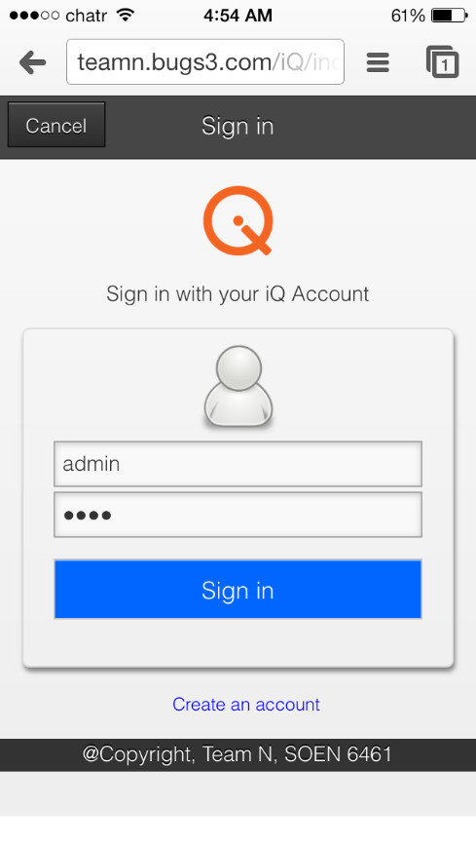
High-Fidelity Prototype
IQ
iOS
SOEN 6461

Slide 9
Go to http://teamn.bugs3.com/iQ/ in your Smart Phone sign up, create survey and publish them, we will display the result at end of demo

Slide 10
Demonstration
http://teamn.bugs3.com/iQ/
SOEN 6461

Slide 11
Q&A
SOEN 6461

